Slide 1
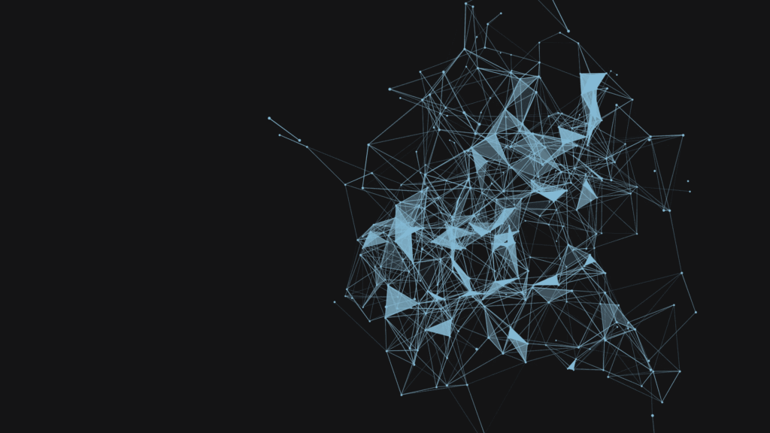
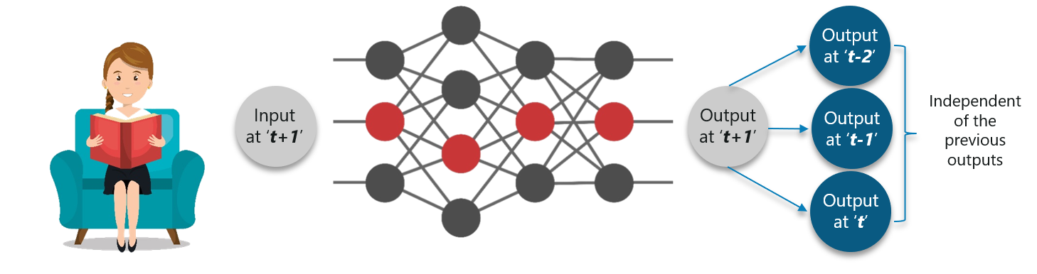
RNN – Recurrent Neural Network

Slide 2
WHAT IS RNN ?
Recurrent Neural Network(RNN) are a type of Neural Network where the output from previous step are fed as input to the current step.
In traditional neural networks, all the inputs and outputs are independent of each other, but in cases like when it is required to predict the next word of a sentence, the previous words are required and hence there is a need to remember the previous words.

Slide 3
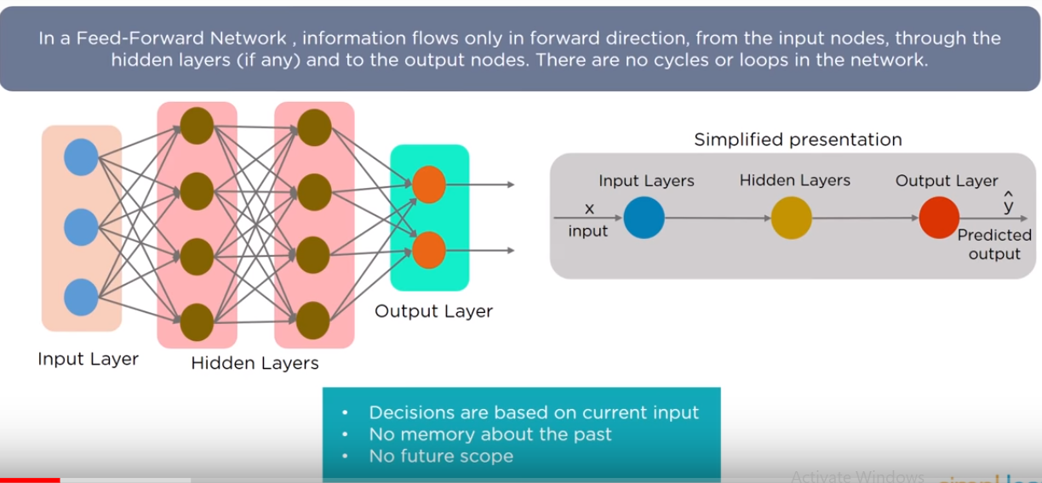
FEED FORWARD NETWORK

Slide 4
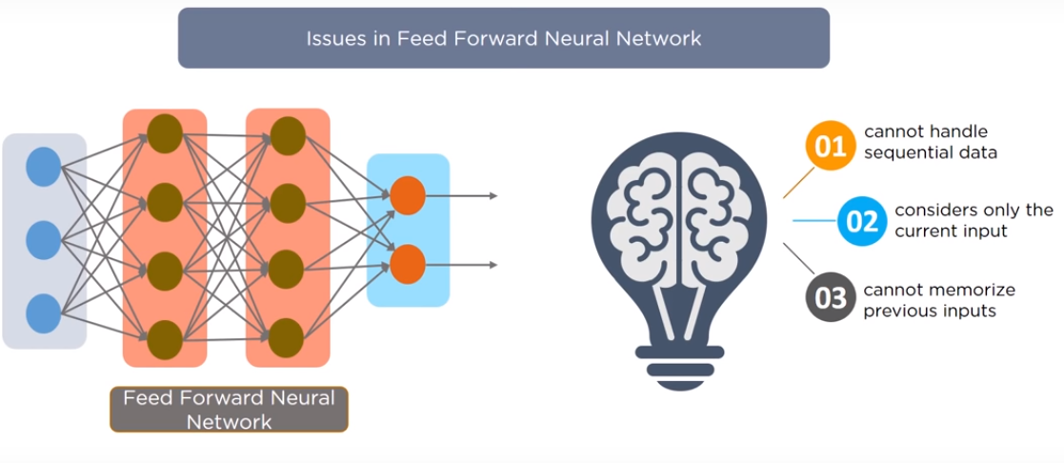
WHY RNN NOW?

Slide 5
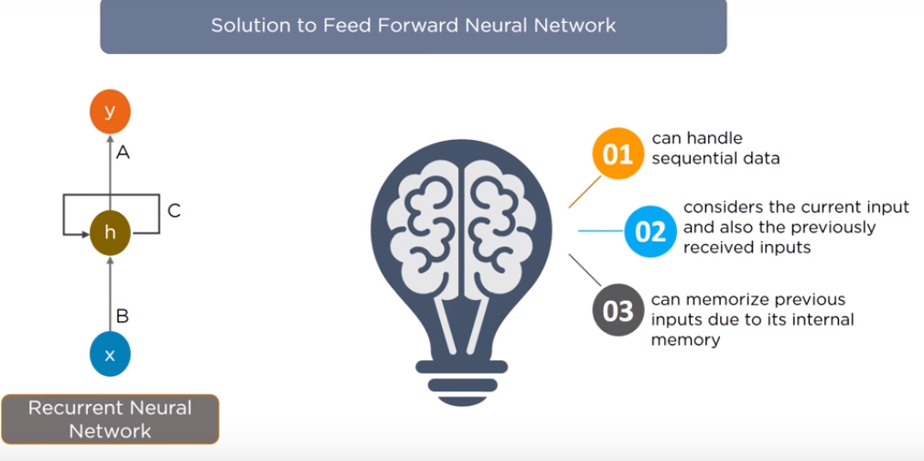

Slide 6
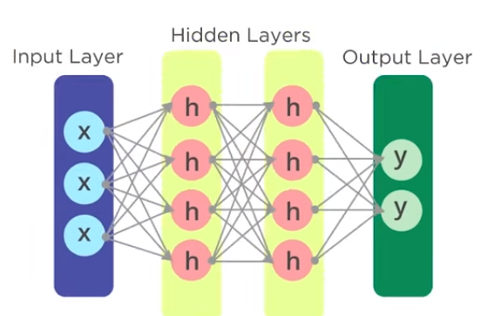
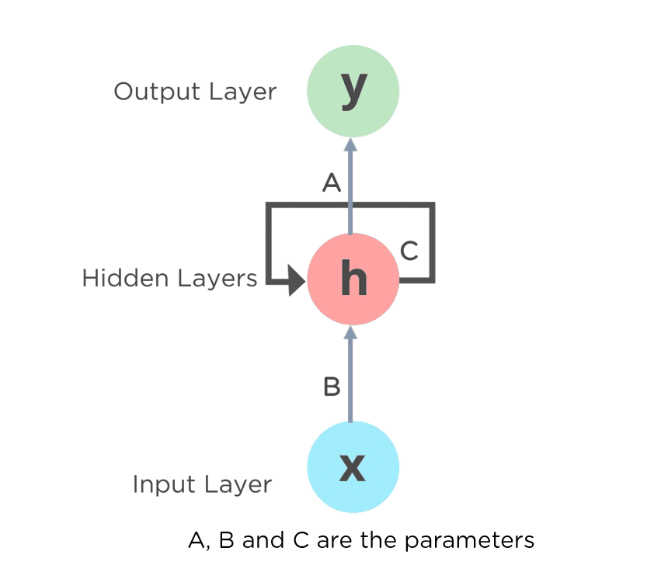
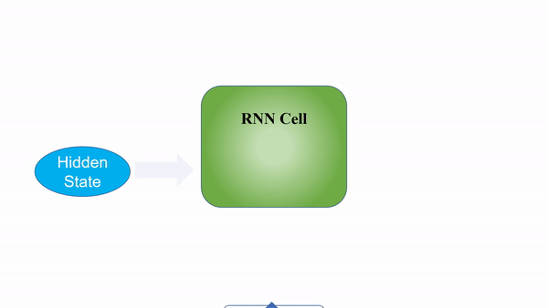
YEAH….IT’S RNN

Slide 7
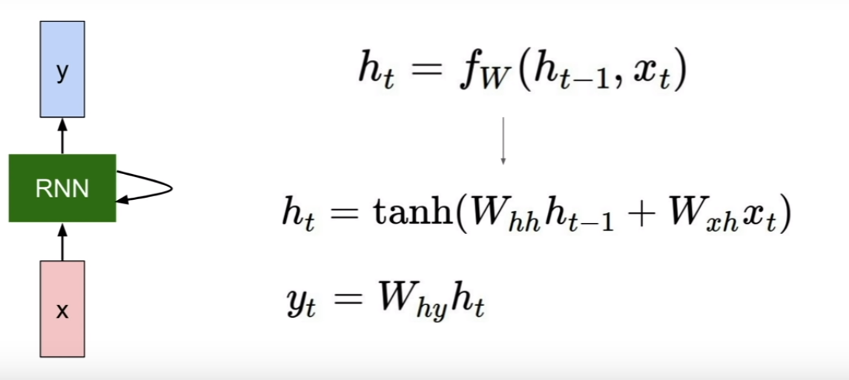
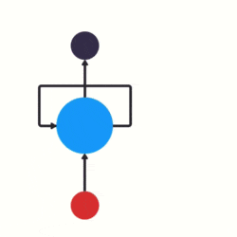
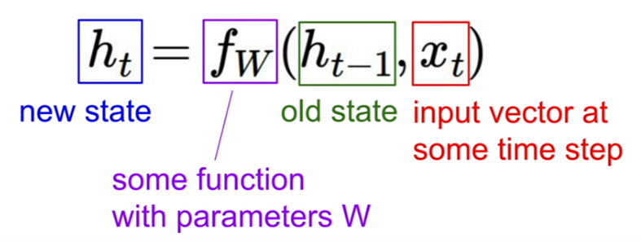
RECURRENT NEURAL NETWORK

Slide 8
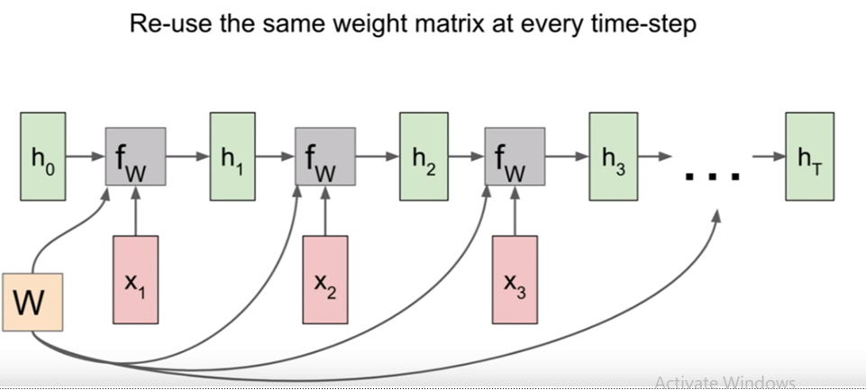
RNN - COMPUTATIONAL GRAPH

Slide 9
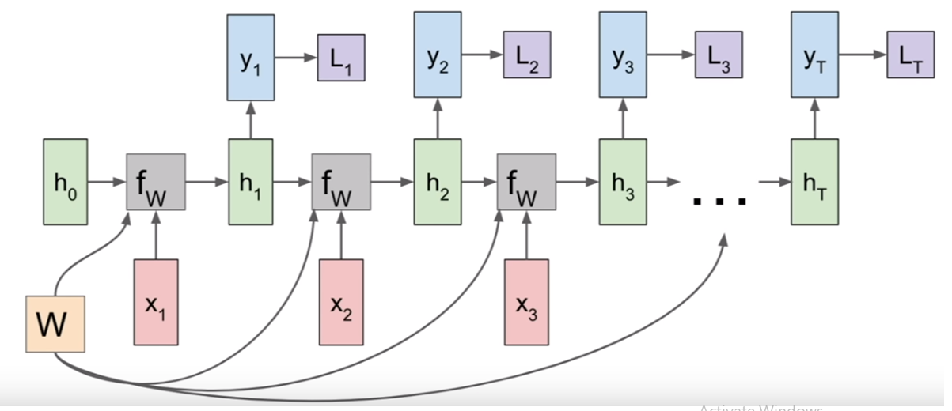
RNN - COMPUTATIONAL GRAPH

Slide 10
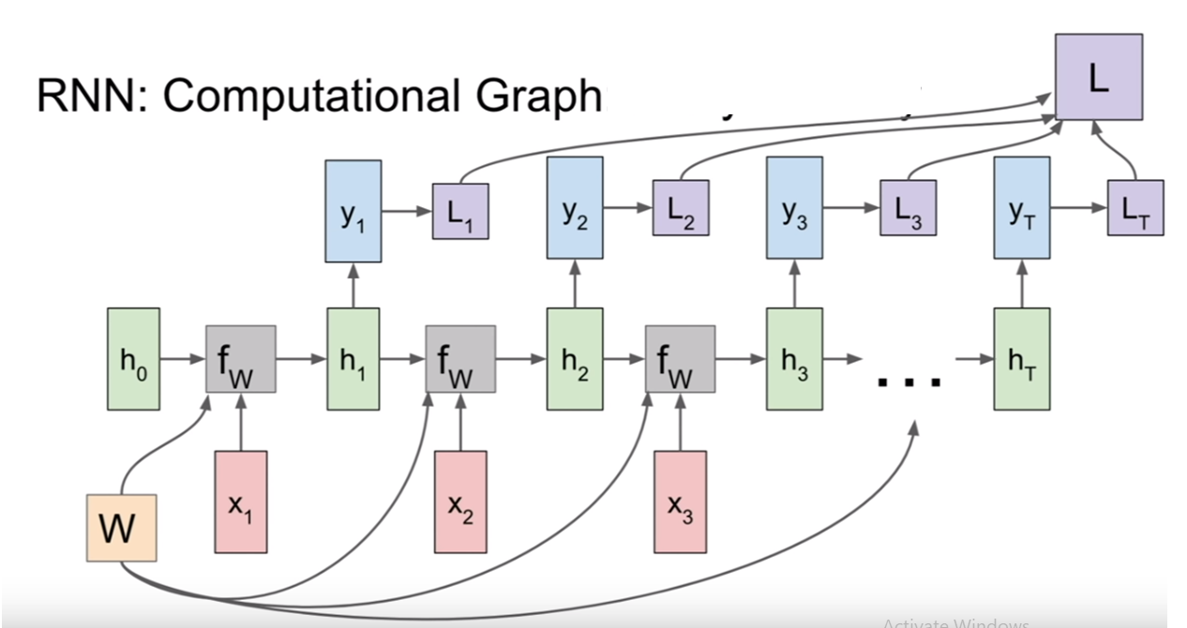
RNN - COMPUTATIONAL GRAPH

Slide 11
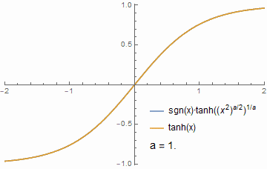
WHY TANH FUNCTION ?
Tanh or hyperbolic tangent Activation Function
tanh is also like logistic sigmoid but better
A tanh function ensures that the values stay
between -1 and 1, thus regulating the output
of the neural network.

Slide 12
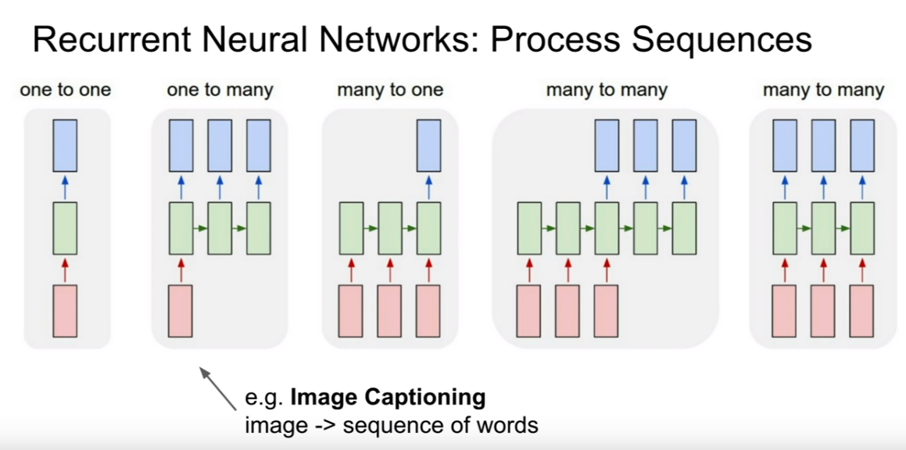
TYPES OF RECURRENT NEURAL NETWORK

Slide 13
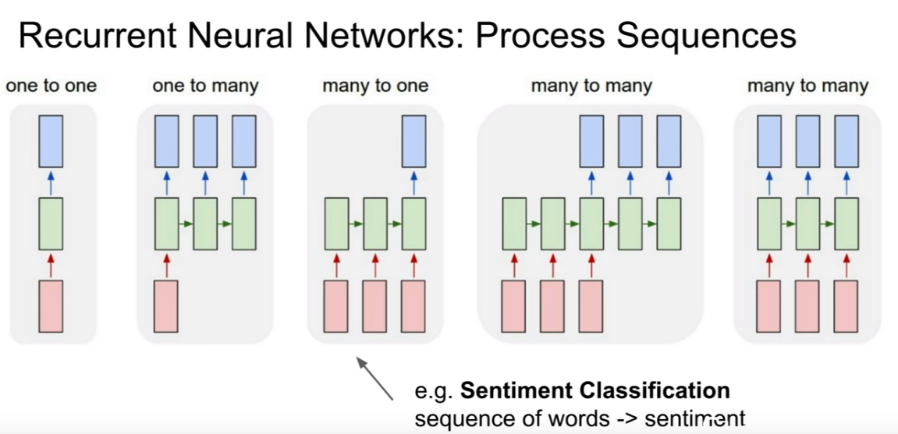

Slide 14
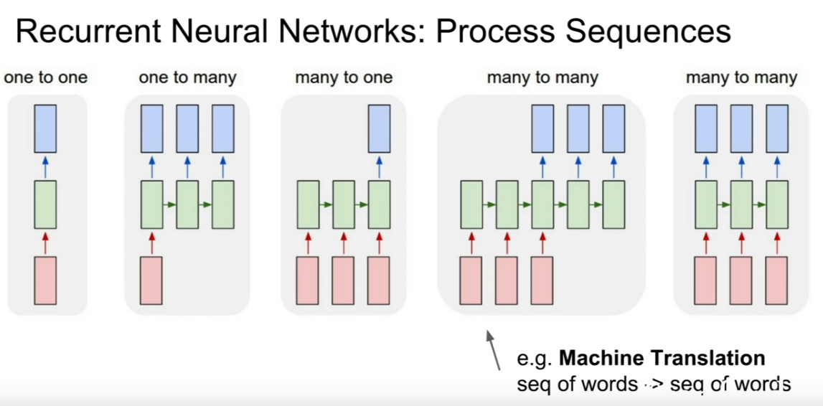

Slide 15
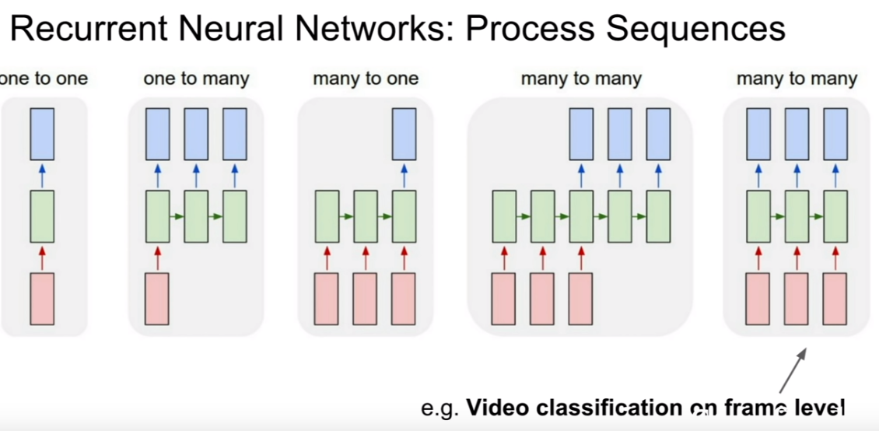

Slide 16
GRADIENT PROBLEM
Feedforward neural networks is to back-propagate error and update the network weights.
Back-propagation breaks down in a recurrent neural network, because of the recurrent or loop connections.
This was addressed with a modification of the Back-propagation technique called Back-propagation Through Time or BPTT.

Slide 17
GRADIENT PROBLEM
When Back-propagation is used in very deep neural networks and in unrolled recurrent neural networks, the gradients that are calculated in order to update the weights can become unstable.
They can become very large numbers called Exploding gradients.
or it become very small numbers called the Vanishing Gradient.

Slide 18
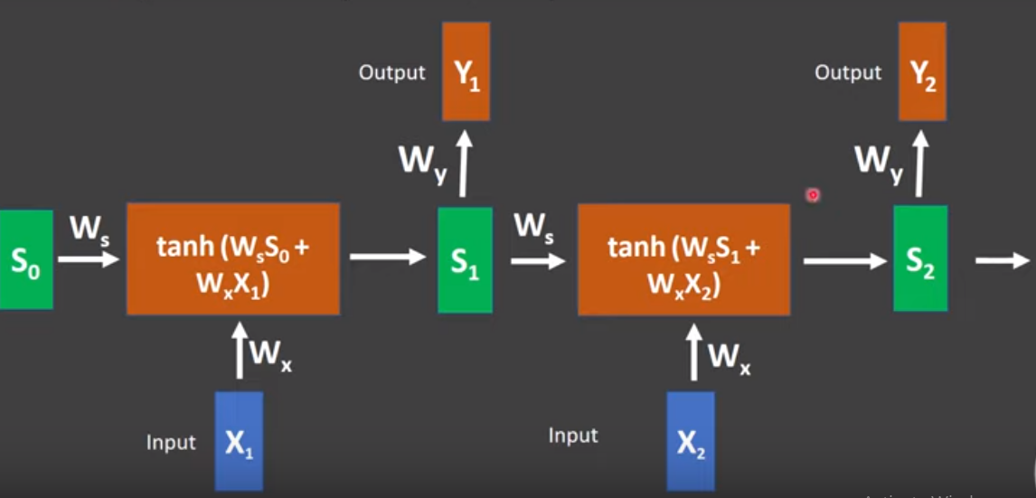
SIMPLE RNN (UNROLLED)

Slide 19
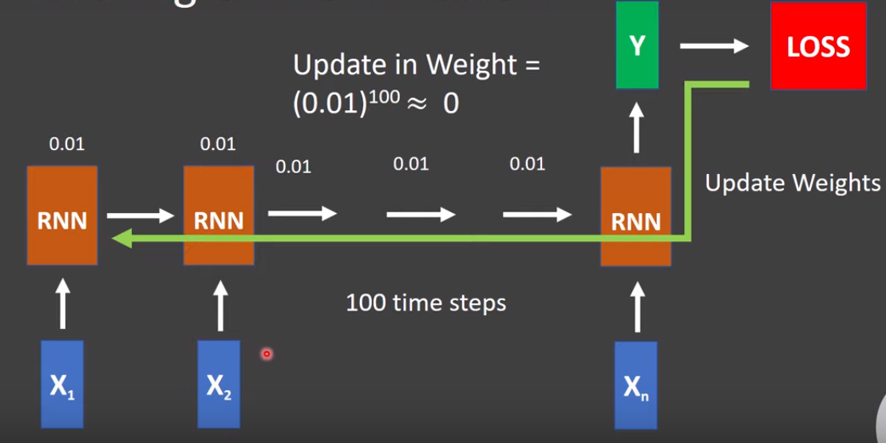
VANISHING GRADIENT PROBLEM

Slide 20
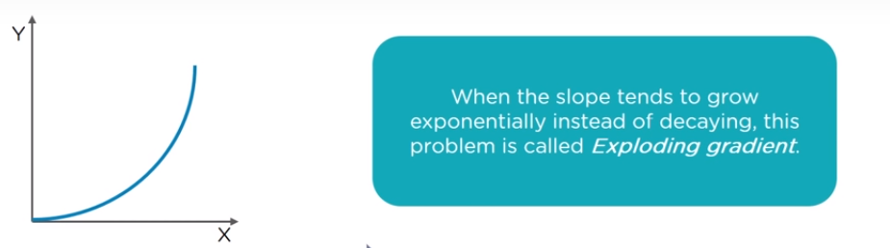
EXPLODING GRADIENT PROBLEM

Slide 21
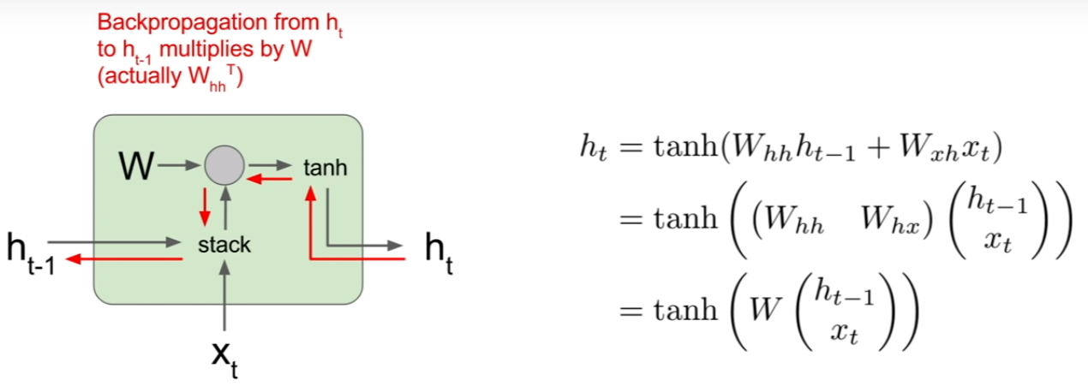
VANILLA RNN GRADIENT FLOW - RNN CELL

Slide 22
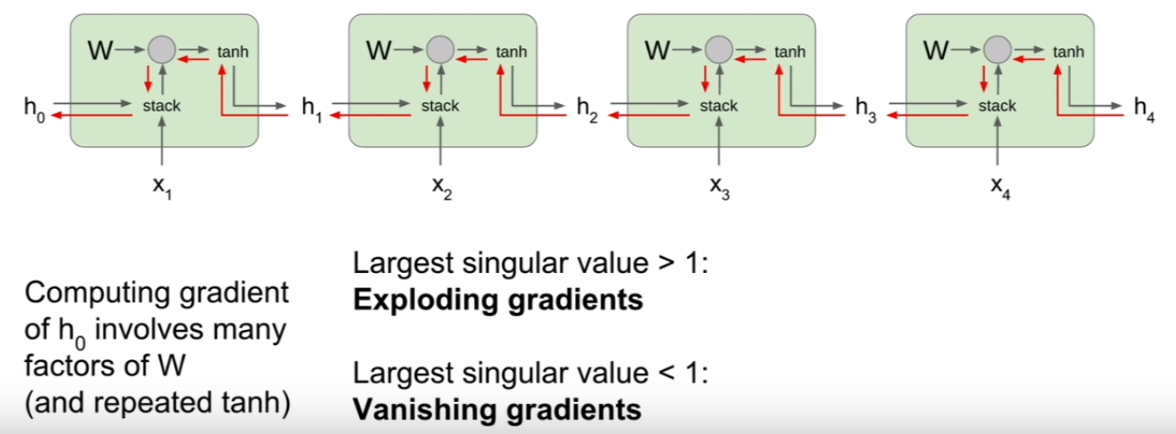
VANILLA RNN GRADIENT FLOW

Slide 23


Slide 24
LSTM – LONG SHORT TERM MEMORY
LSTMs are explicitly designed to avoid the long-term dependency problem.
well-suited to classifying, processing and making predictions based on time series data, since there can be lags of unknown duration between important events in a time series.
It developed to deal with the exploding and vanishing gradient problems that can be encountered when training traditional RNNs.

Slide 25
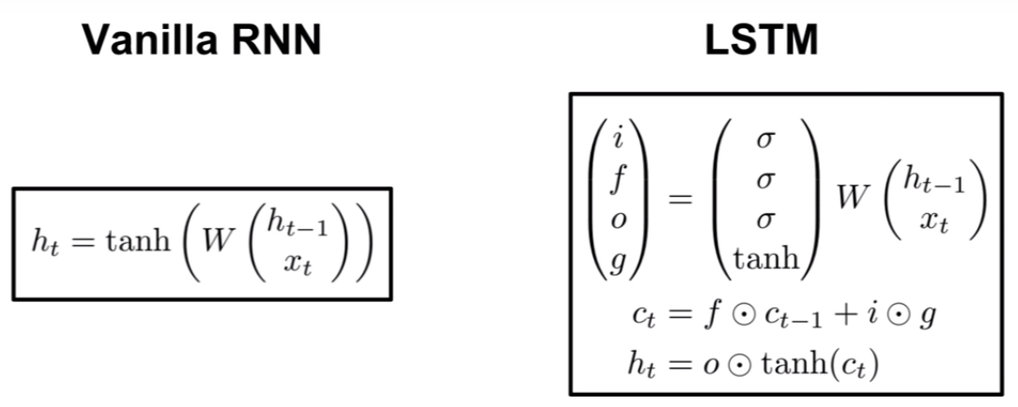
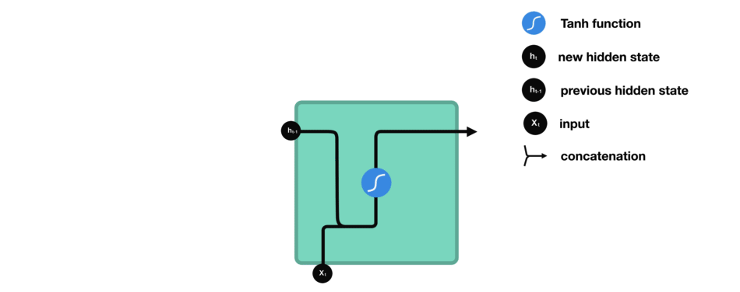
LSTM – LONG SHORT MEMORY CELL

Slide 26
LSTM – FOUR STATES
Forget Gate: conditionally decides what information to discard from the unit.
Input Gate: conditionally decides which values from the input to update the memory state.
Gate Gate : decides how much to write to cell
Output Gate: conditionally decides what to output based on input and the memory of the unit.

Slide 27
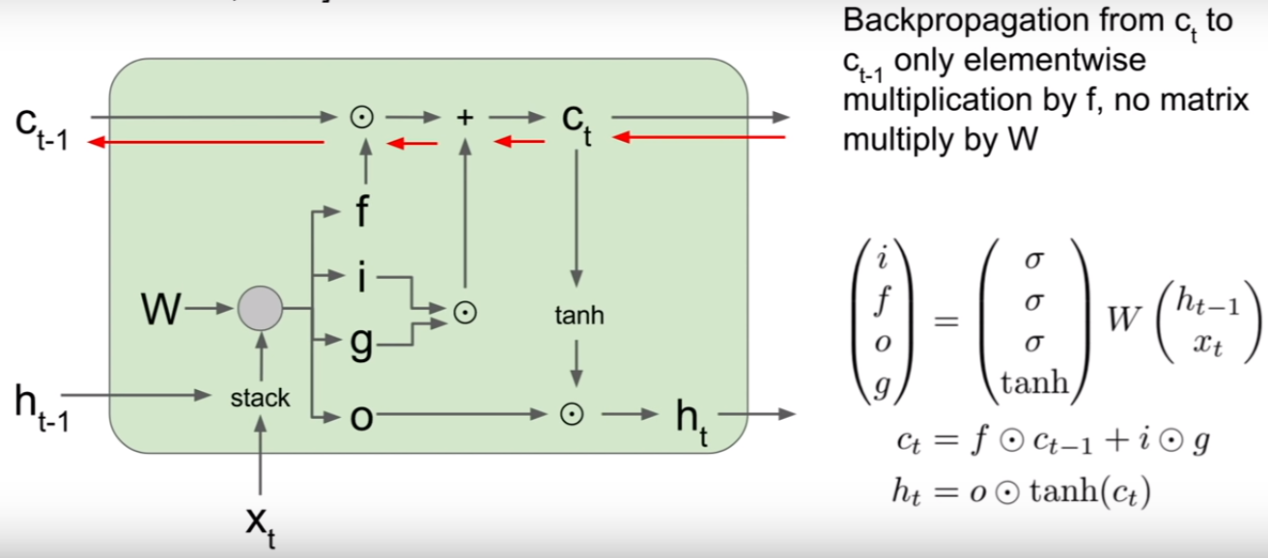
LSTM – GRADIENT FLOW

Slide 28
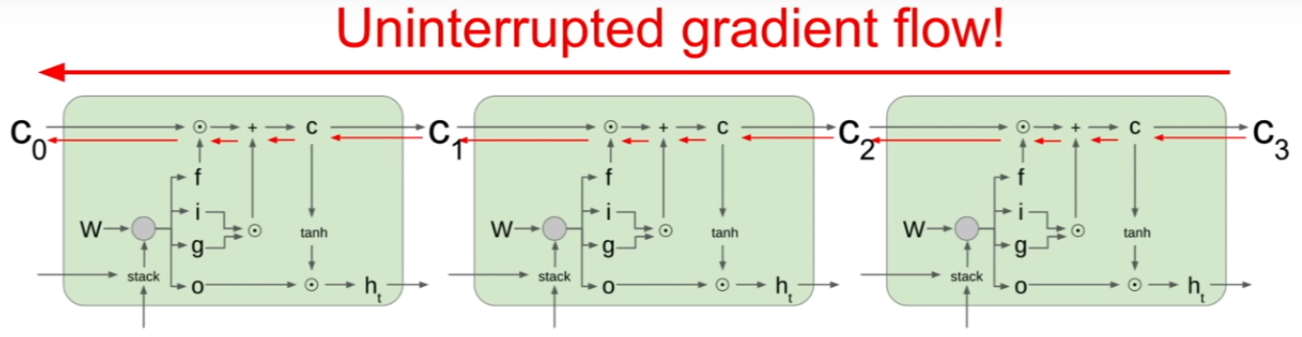

Slide 29
GRU – GATED RECURRENT UNIT
GRU is the newer generation of RNN network.
Here we don’t have the cell gate and it’s using the hidden state to share the information instead.
Here it’s less tensor operation so that it’s faster & efficient than LSTM.
As like LSTM, GRU also not able to handle the long-term dependencies.
Update Gate – It’s like input gate of LSTM (i.e) what’re valid information that needs to be updated into cart.
Reset Gate – It’s throwing away invalid data which not serves the enough information.

Slide 30
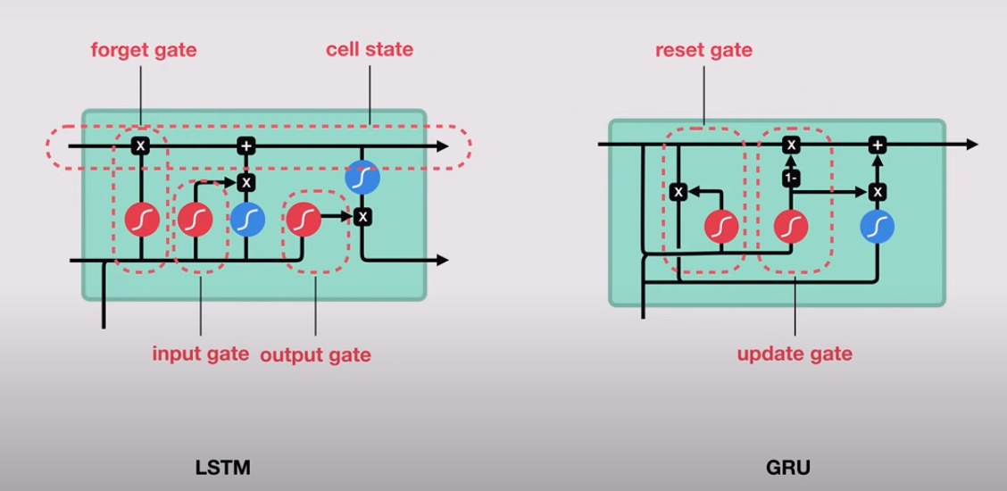
LSTM vs GRU – STATE LEVEL DIFFERENCE

Slide 31

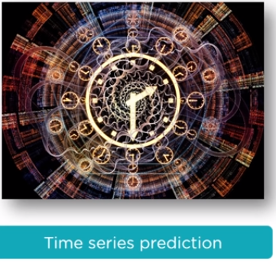
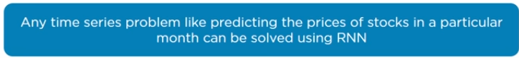
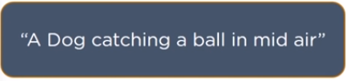
APPLICATIONS OF RNN

Slide 32
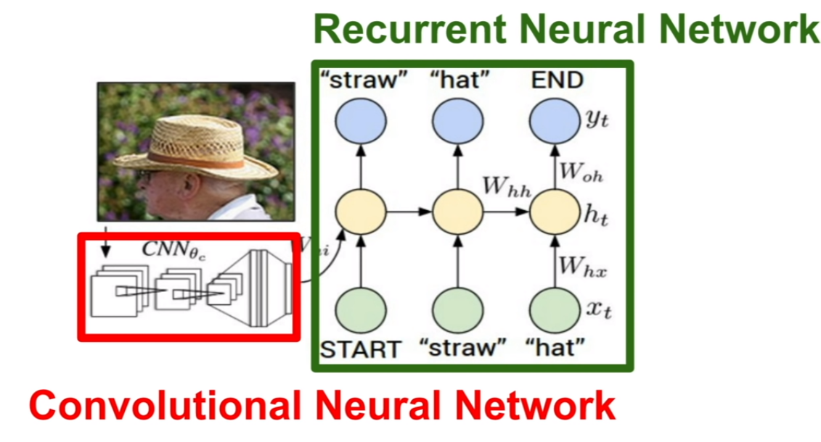
RNN FOR IMAGE CLASSIFICATION

Slide 33
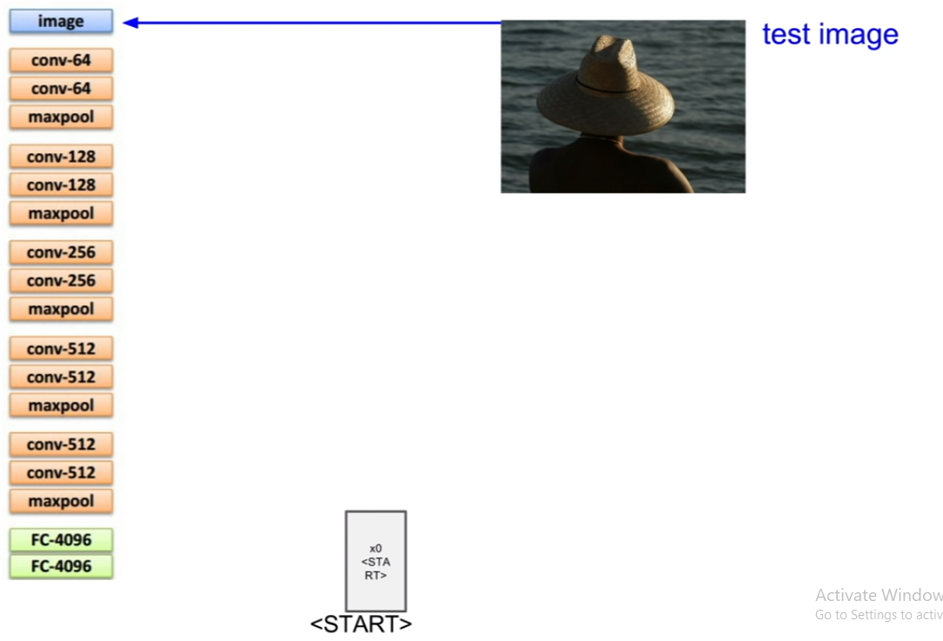

Slide 34
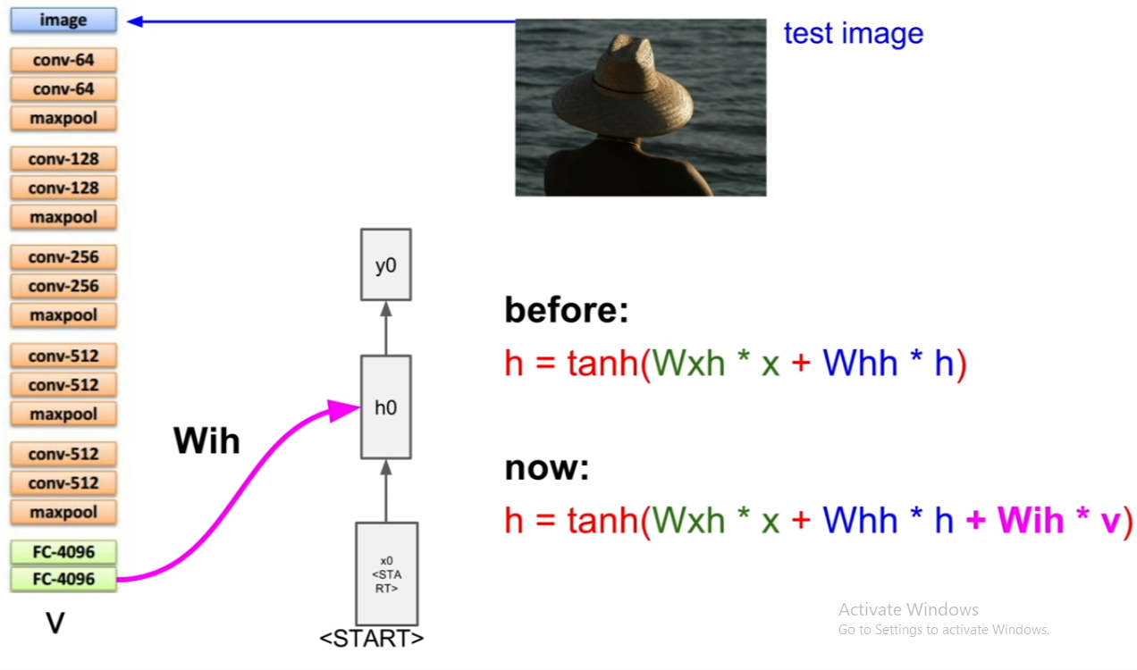

Slide 35
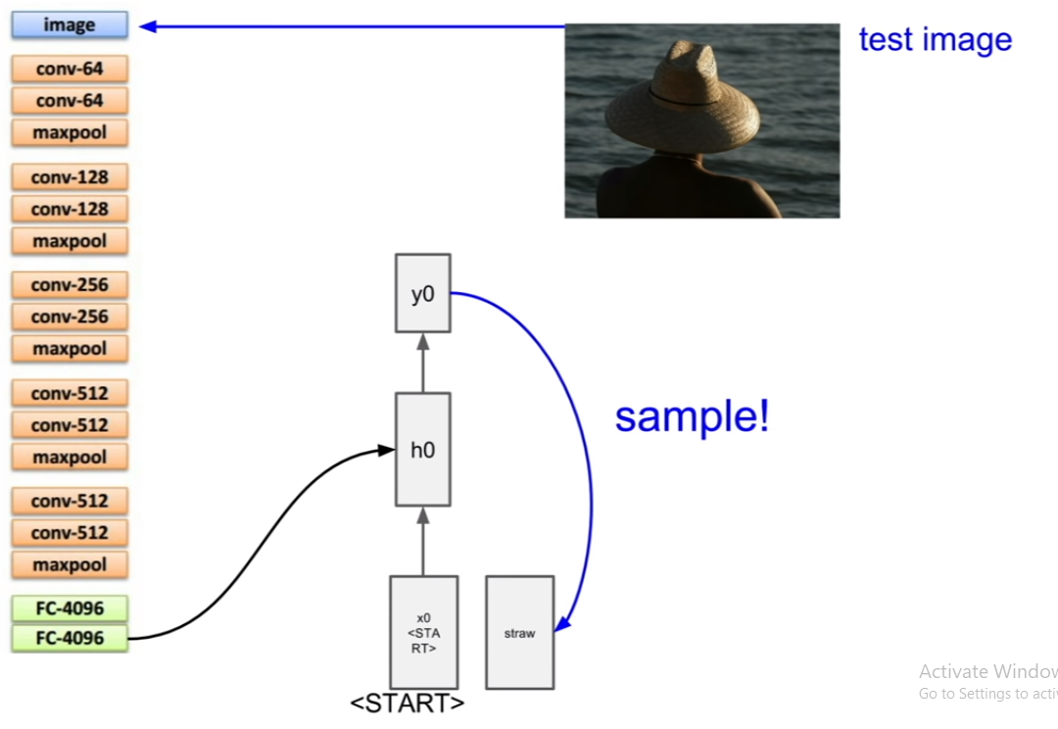

Slide 36
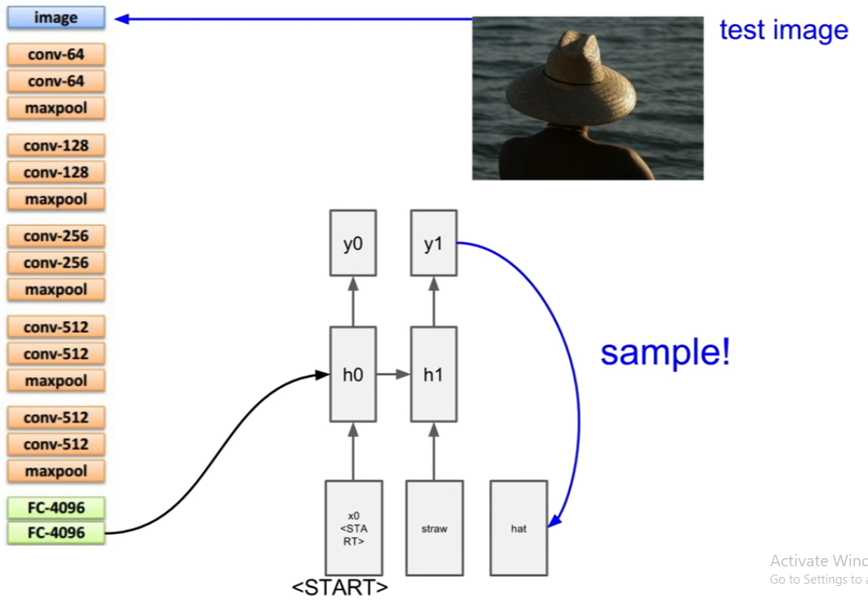

Slide 37
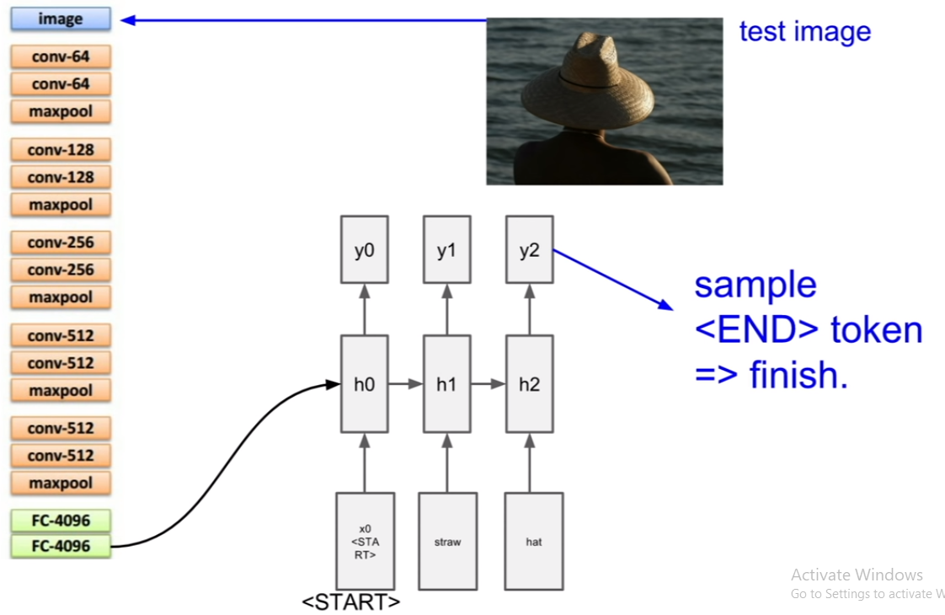

Slide 38
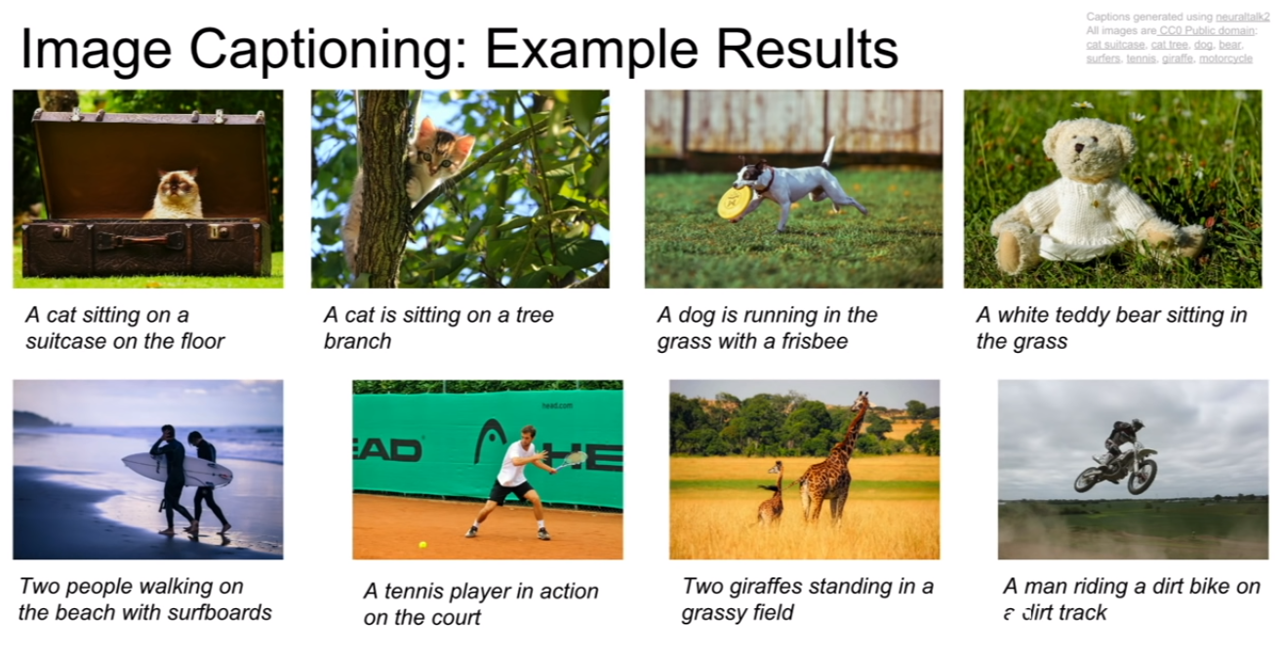

Slide 39


Slide 40
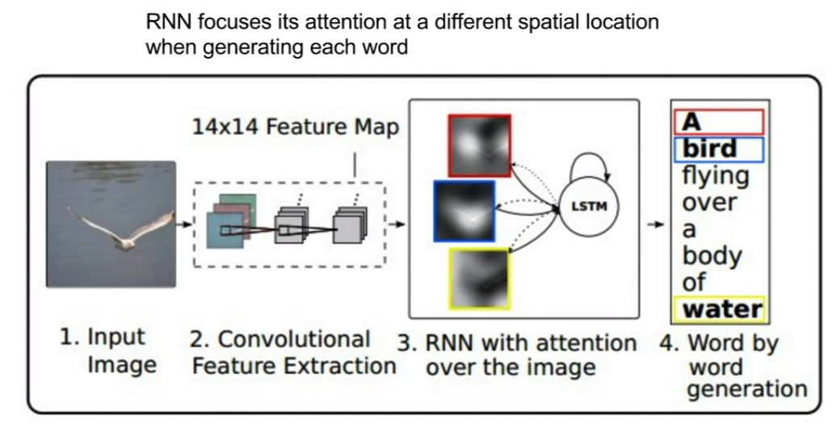
IMAGE CAPTIONING WITH ATTENTION

Slide 41
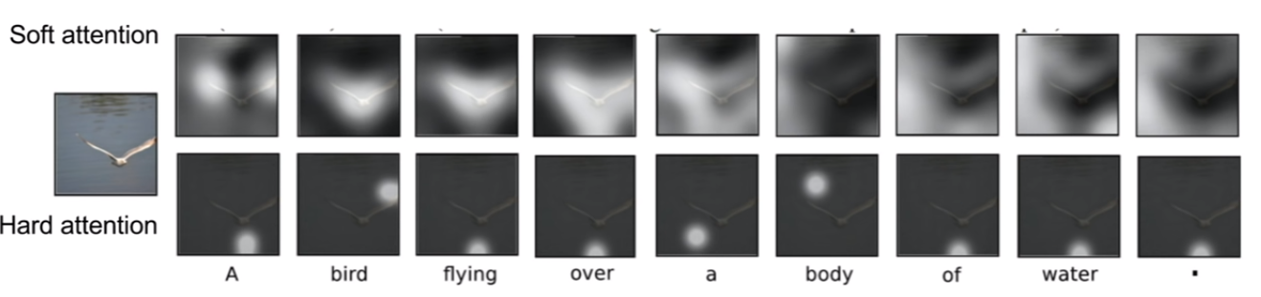
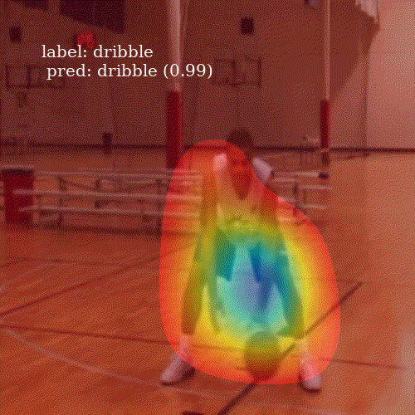
SOFT vs HARD ATTENTION

Slide 42
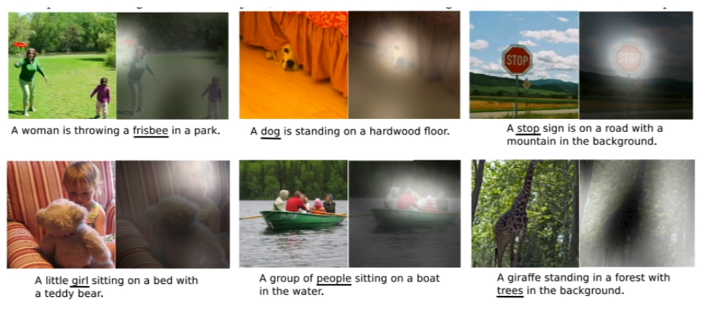

Slide 43
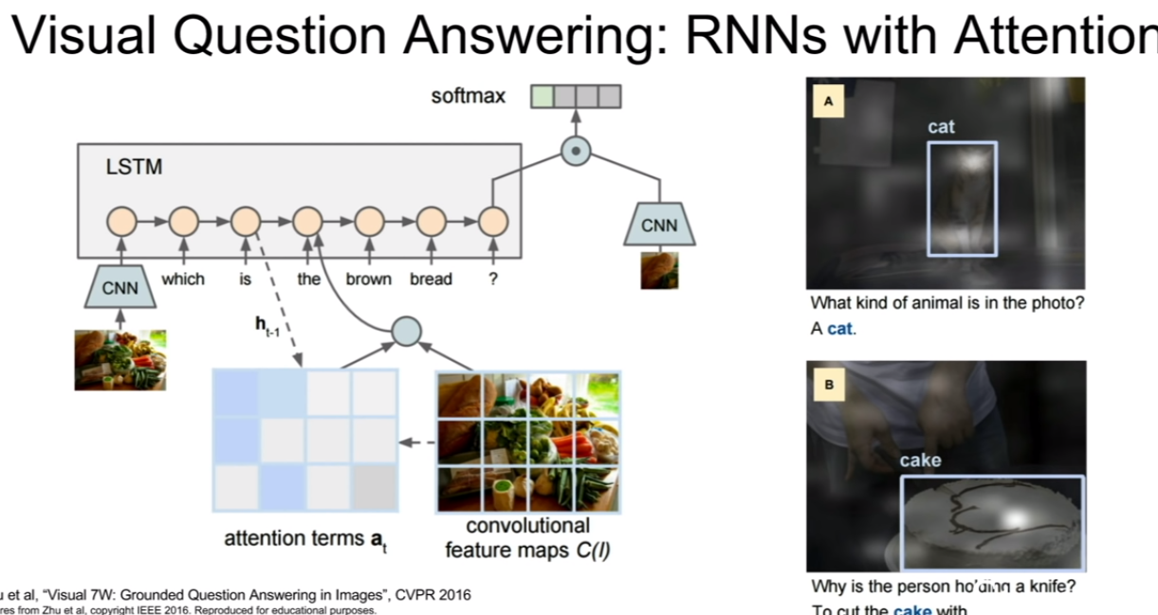
What

Slide 44


Slide 45
SENTIMENT ANALYSIS
SARCASM DETECTION

Slide 46

Its time for Action!

Slide 47
THANKS!
Any questions?

